Slide 1
Read Write Inc

Slide 2
In this session
Blending for reading: ‘Fred Talk’
From blending to reading
Segmenting for spelling: ‘Fred Fingers’
How to support blending and segmenting at home

Slide 3
EYFS Speed Sounds

Slide 4
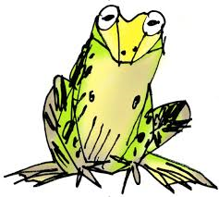
Fred Talk
Say ‘hello’ to Fred.
Fred can only talk in sounds.
He says ‘c-a-t’ not ‘cat’.
We call this Fred Talk.
You can use Fred Talk at home e.g. get your c-oa-t, time for b-e-d.

Slide 5
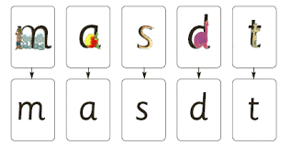
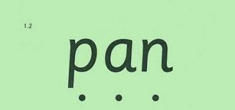
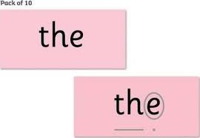
Blending using Fred Talk

Slide 6
Storybooks

Slide 7
Fred Fingers

Slide 8
At home
Reading to your child and enjoying books
Rhymes / songs
Word games and ‘Fred Talk’
When children are ready:
If they are interested, sound out and blend some simple words in books
Praise attempts at writing
Later on support spelling using ‘Fred Fingers’
Magnetic letters

Slide 10
More Information
Oxford Owl Website www.oxfordowl.co.uk
https://home.oxfordowl.co.uk/how-can-i-support-my-child-with-phonics/
Guide to Read, Write Inc:
https://home.oxfordowl.co.uk/reading/reading-schemes-oxford-levels/read-write-inc-phonics-guide/

