Slide 1
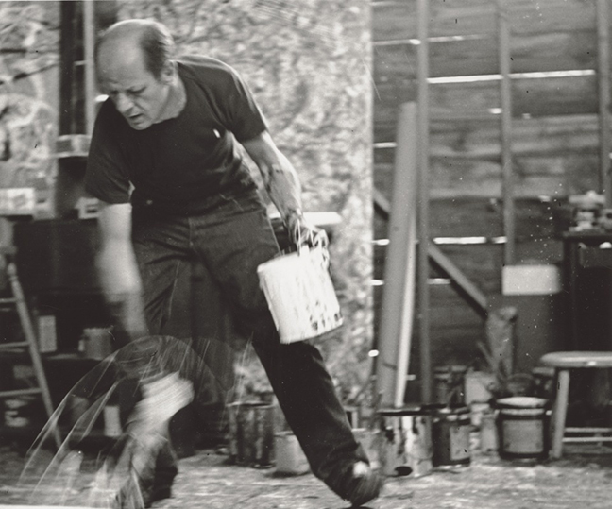
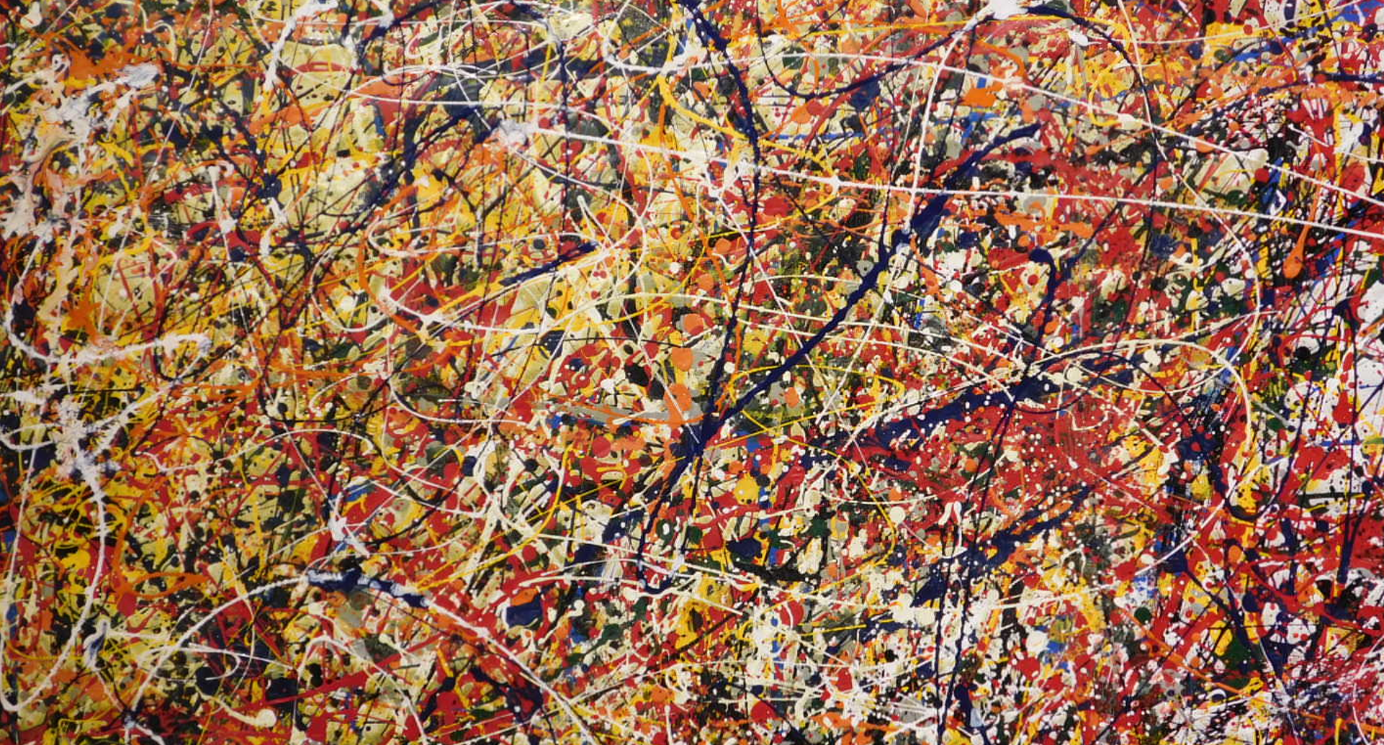
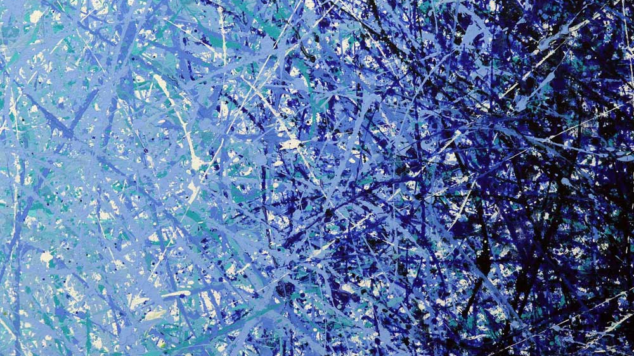
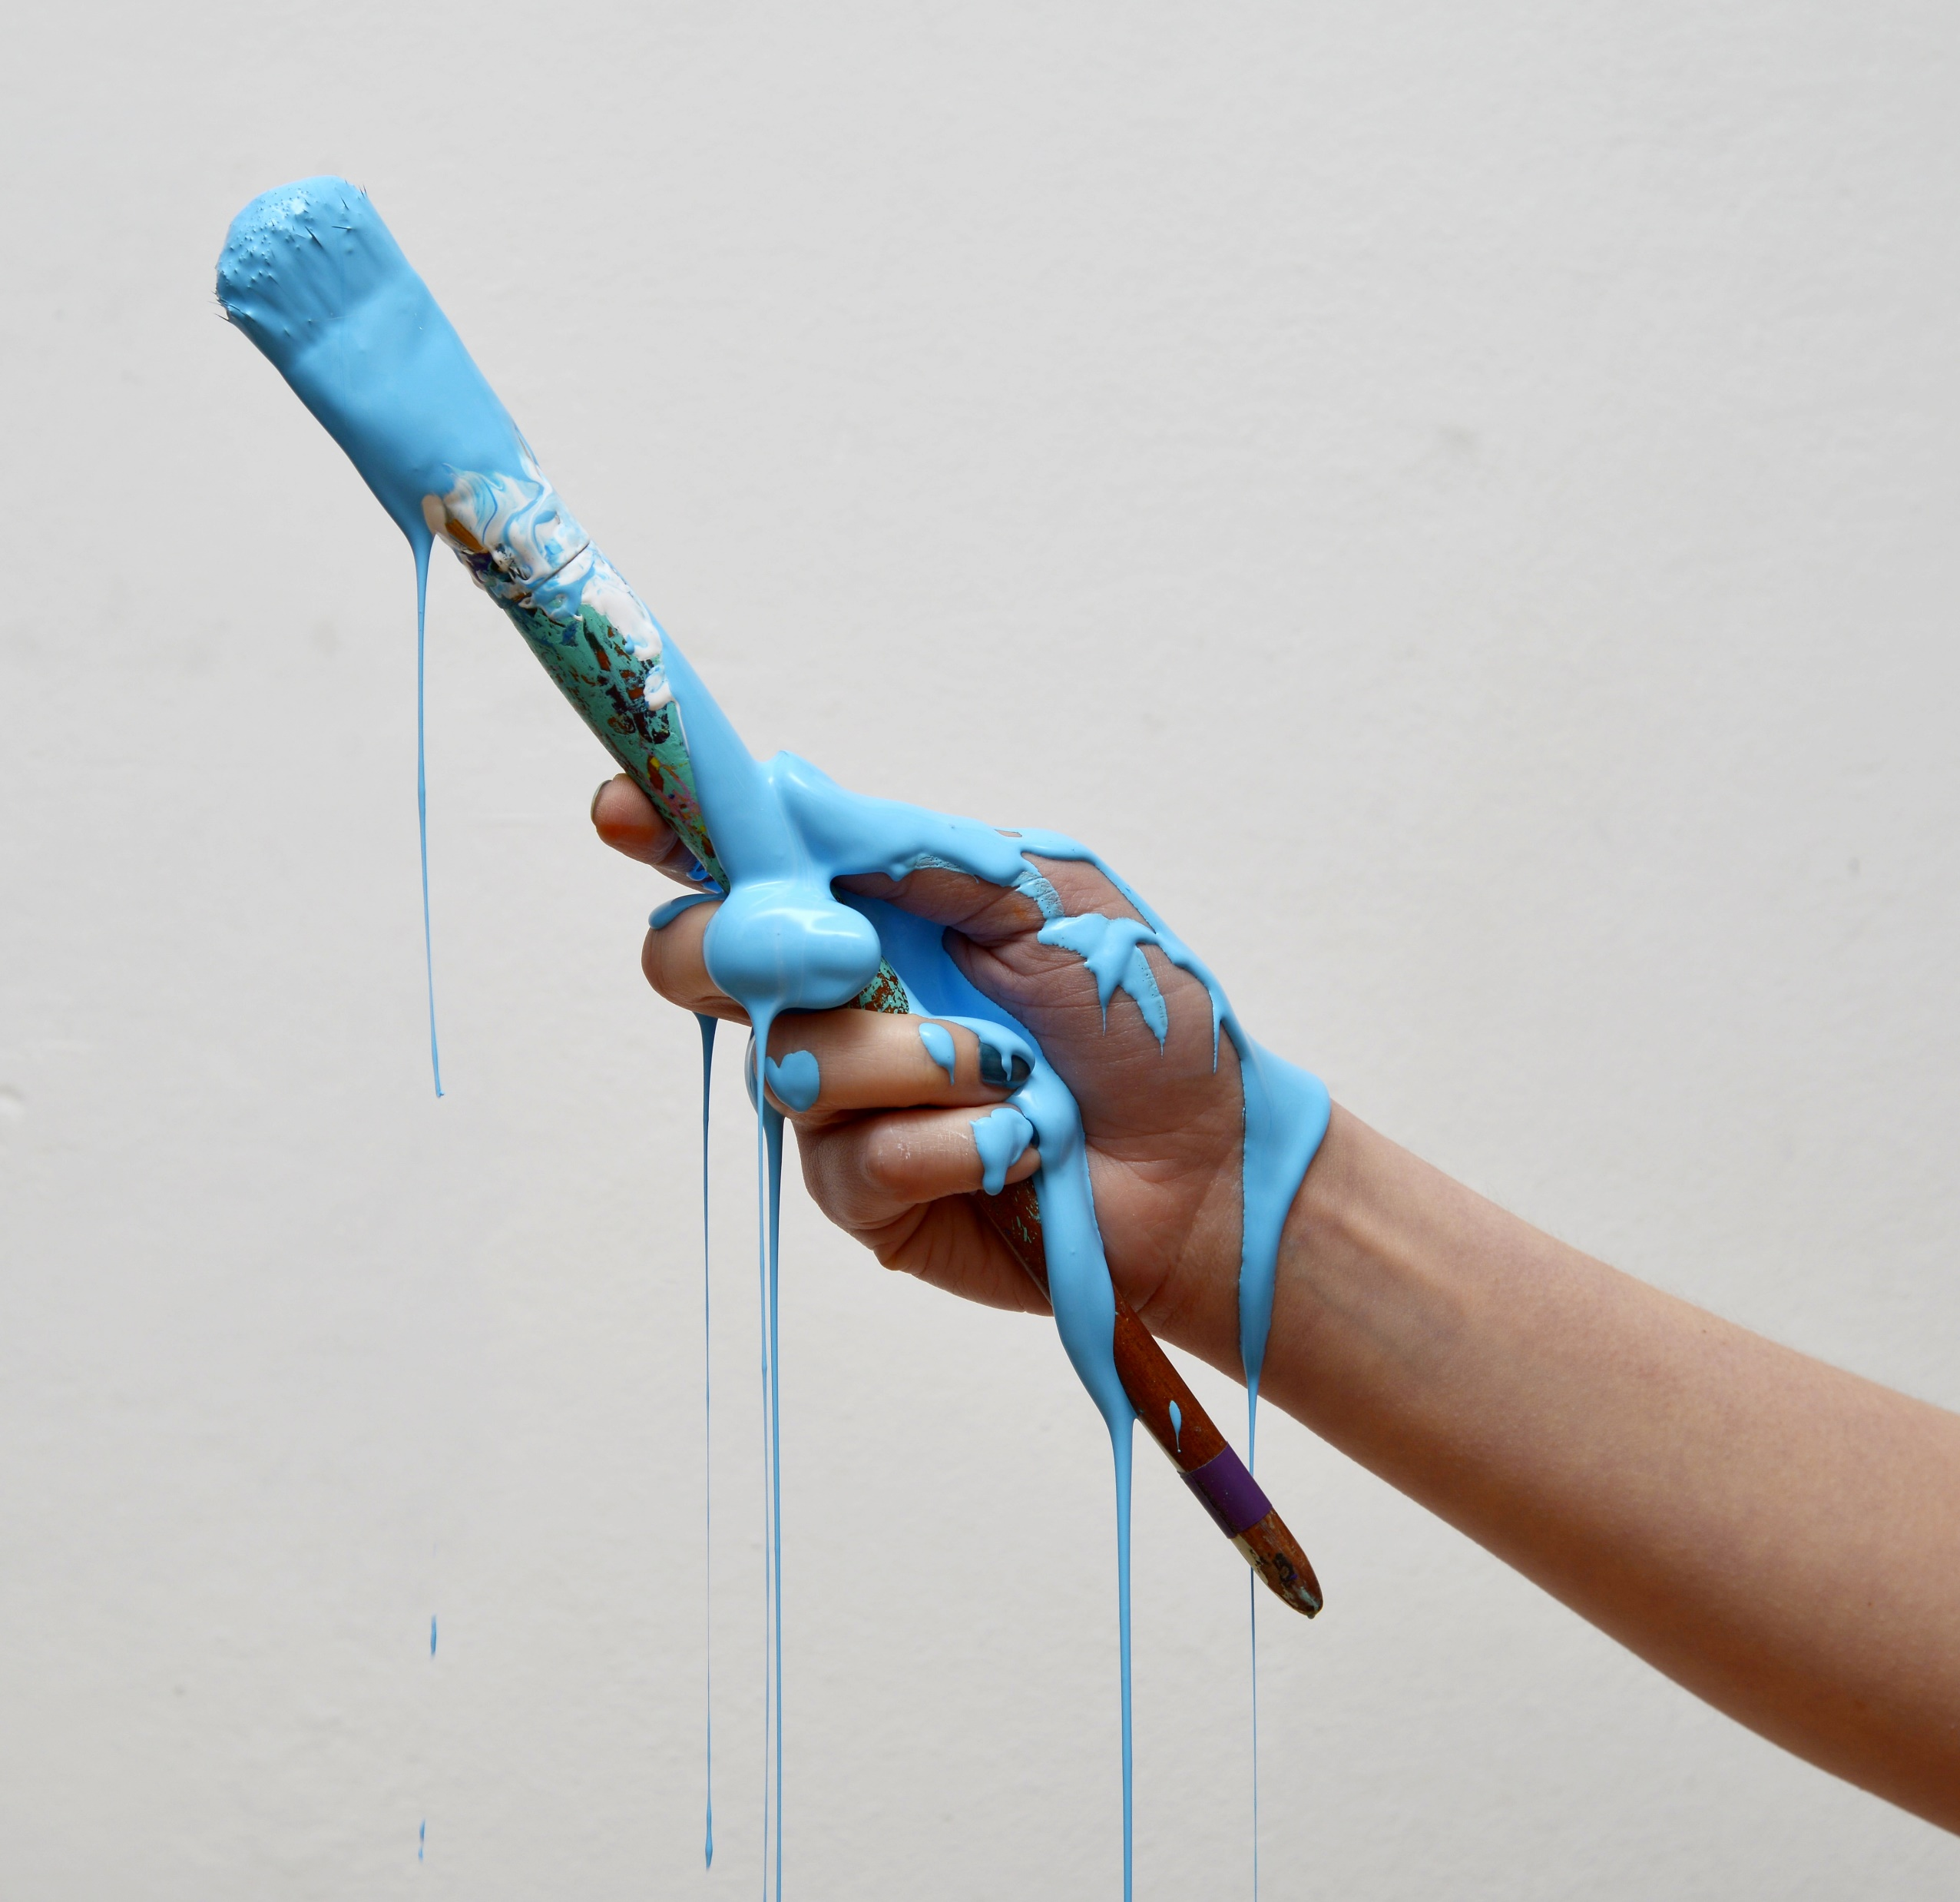
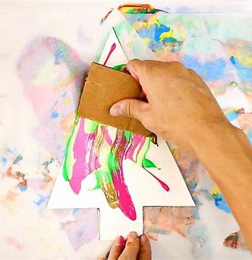
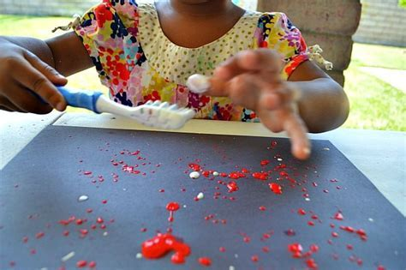
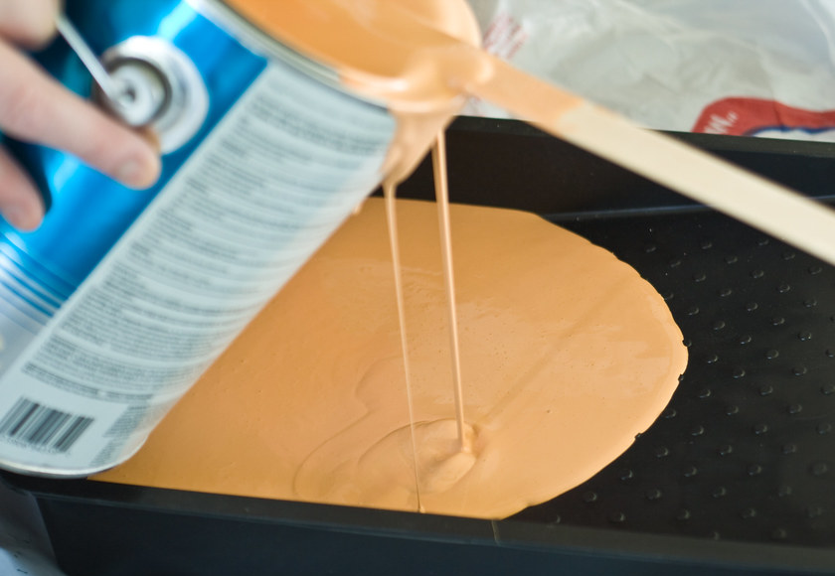
EYFS – Jackson Pollock
Tier 3 vocabulary
Action painting | Action painting is when you move the paint by splashing, throwing, or pouring it.
Abstract Art | Abstract art uses shapes, marks and colours.
Jackson Pollock was an Abstract Painter.
Features and skills
drip
scrape
splash
drag
flick
pour
dribble
Pre-school – children experimented with paint brushes.
Year 1/2 – children will use different paint techniques and colours for their Hundertwasser work.

