Slide 1


Talk for Writing

Slide 2
Why Talk for Writing?
Aligns with school’s aim to provide children with powerful knowledge
Success rates in schools have been high
Gives children confidence, particularly when writing at length
Allows children to learn higher level vocabulary and more challenging grammatical concepts in context
Improves children’s speech and language and story telling skills
Endorsed by the Local Authority
Ofsted state:
‘Pupils’ achievement in writing is improving in each year group. This is because the expectations of the quantity and quality of what pupils write have increased.’
‘Teachers have raised their expectations of what the most able pupils can achieve, particularly in their writing.’

Slide 3
Imitation
Begins with a ‘Cold Task’
Teachers choose/write a high quality text which contains the necessary knowledge to move children on in their writing
Children learn text off by heart using a text map and actions
Create a class ‘toolkit’ of features

Slide 4
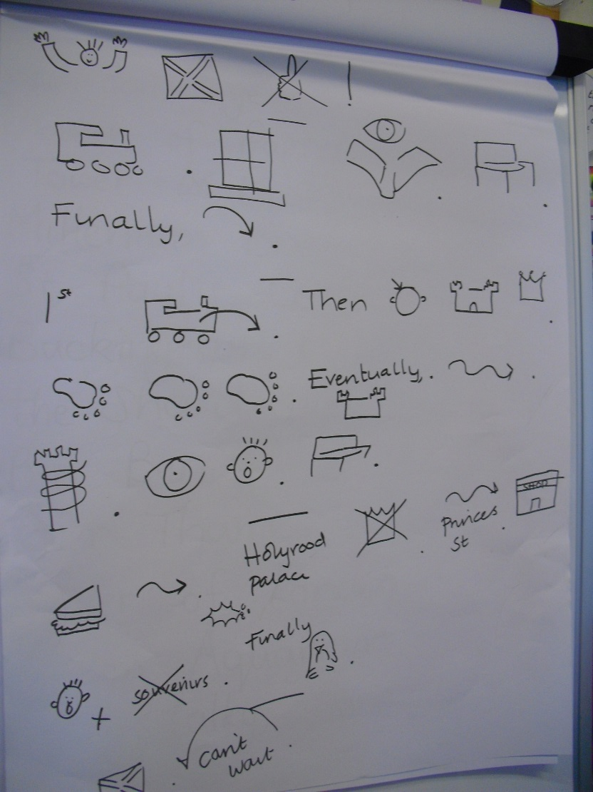
Text Map

Slide 5
Talk for writing in Early Years
M:\Videos\Reception\RLJ\CIMG0222.AVI

Slide 6
Innovation/ Independent
Children adapt the original text, ‘magpie-ing’ high quality sentence structure, ideas and vocabulary
Teachers draw on other high quality texts to model features of the text-type
Writing is modelled by the teacher
Children apply what they have learnt to produce a piece of writing
Writing in other curriculum subjects
Good examples are shared and assessed as a class

Slide 7
What has the impact been?
Raised profile of writing across the school
End of KS Statutory test data- CPS above national figures for children working at Expected Standard and in Greater Depth towards expected standard
Quality of writing in other curriculum areas has improved with children apply skills
Ofsted
‘The ‘knowledge-rich’, broad curriculum lends itself to many more opportunities for pupils to write in other subject areas. Pupils are therefore rehearsing their writing more regularly and their books show that they are applying their skills more efficiently when they complete their extended writing.’

Slide 8
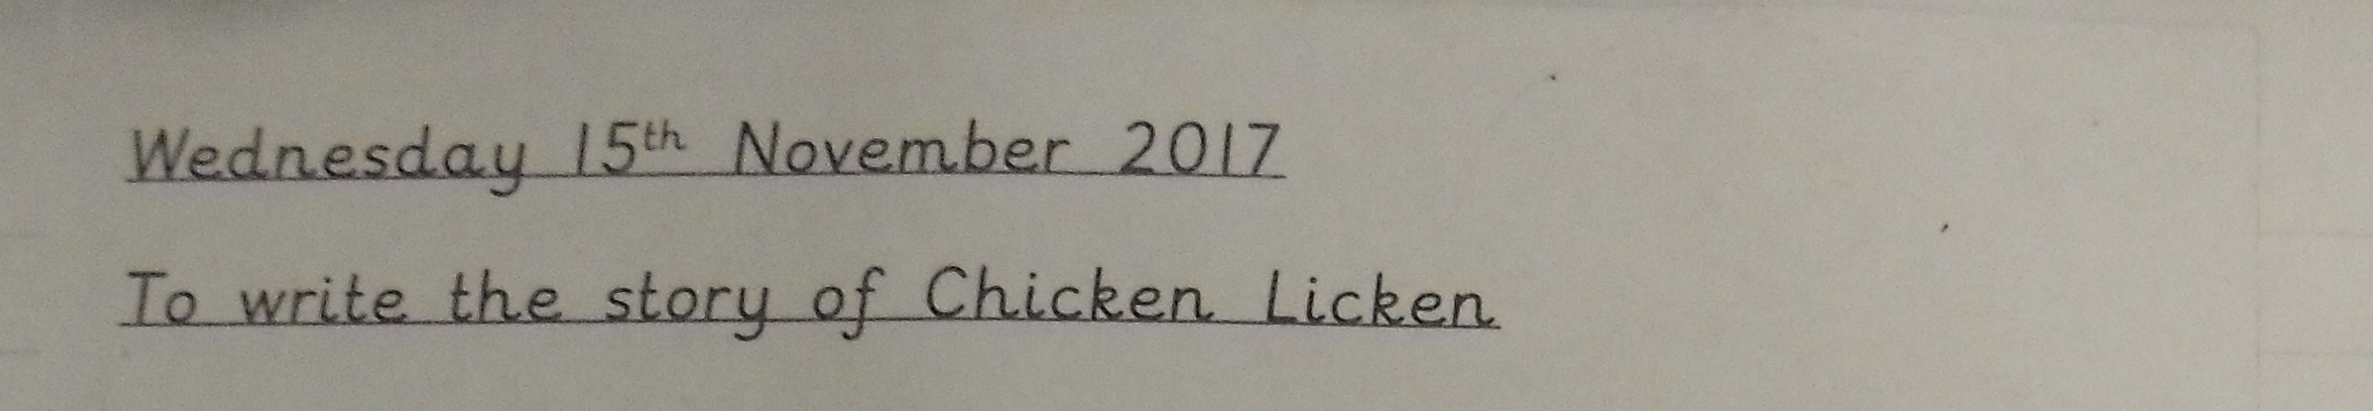
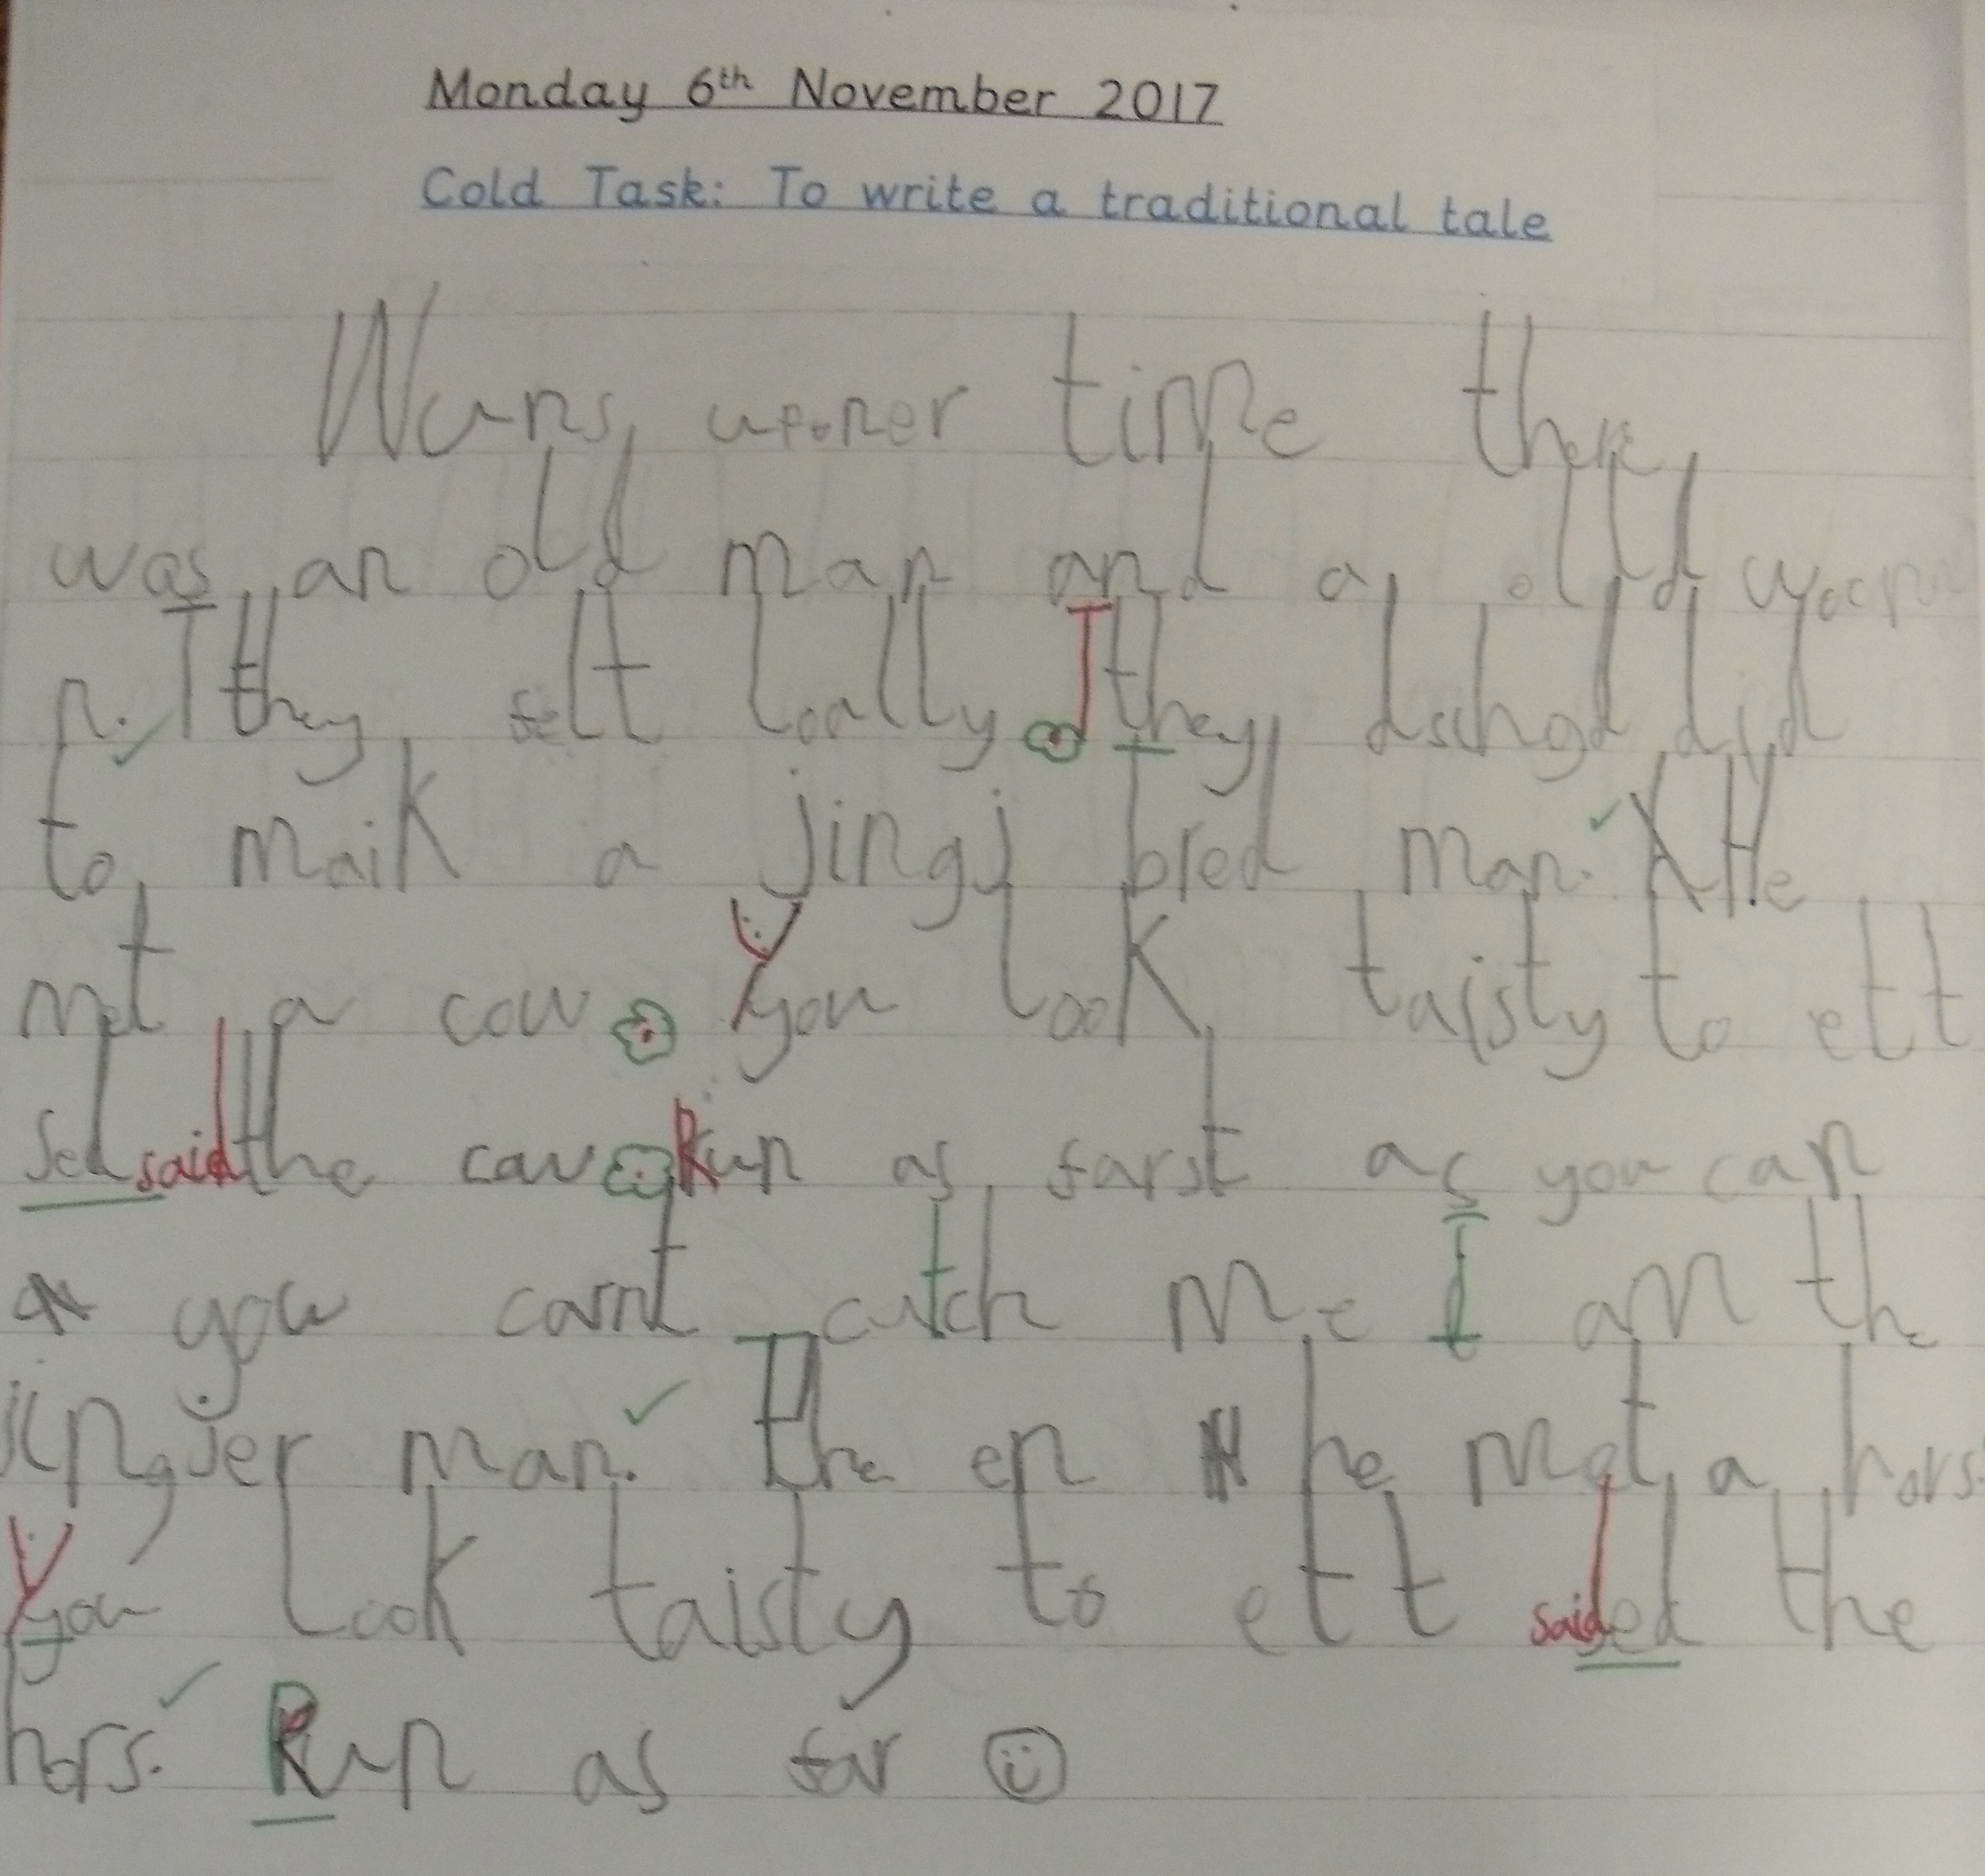
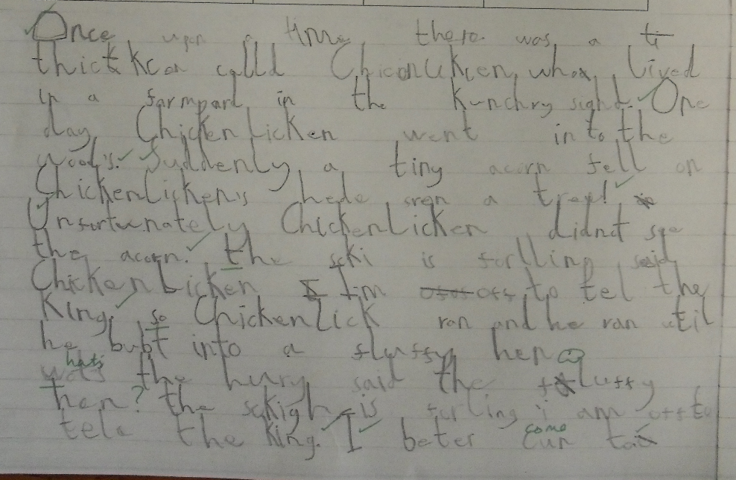
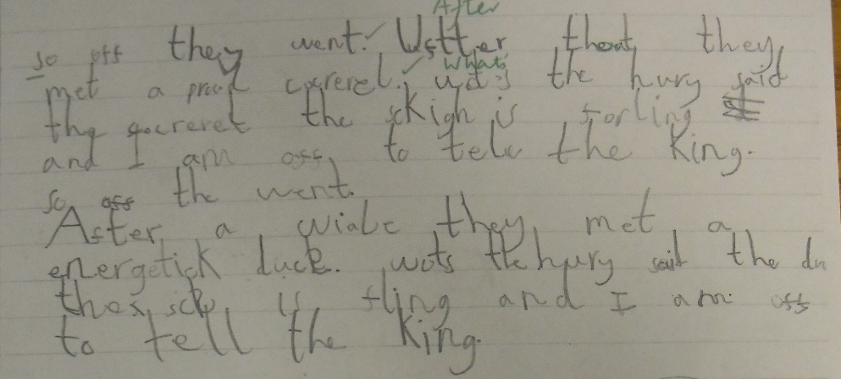
Progress from cold to hot tasks
Year 1 Cold task
Year 1 imitation task

Slide 9
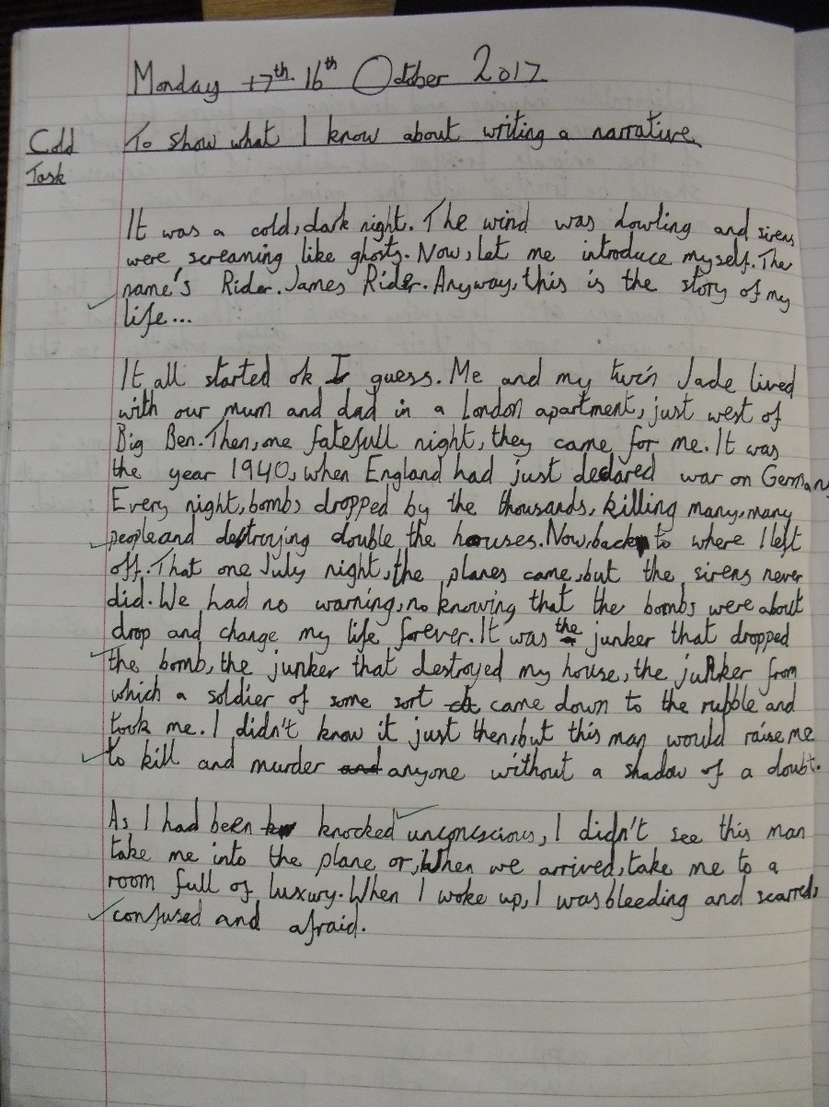
Progress from cold to hot tasks
Year 6 historical
Narrative cold task

Slide 10
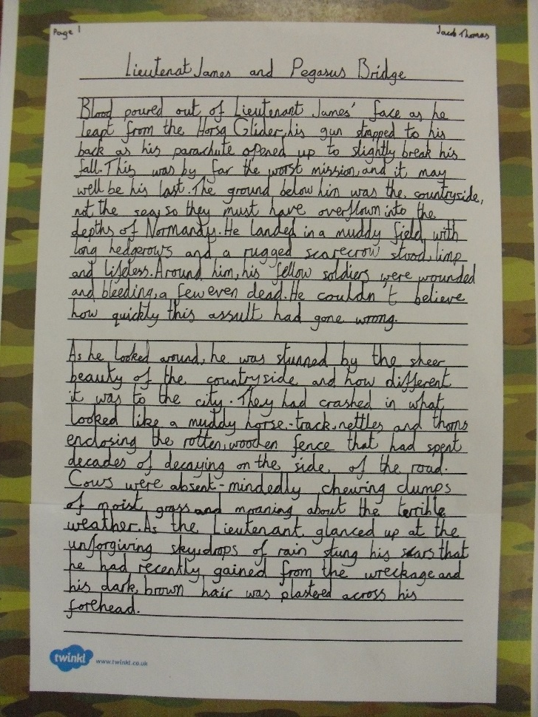
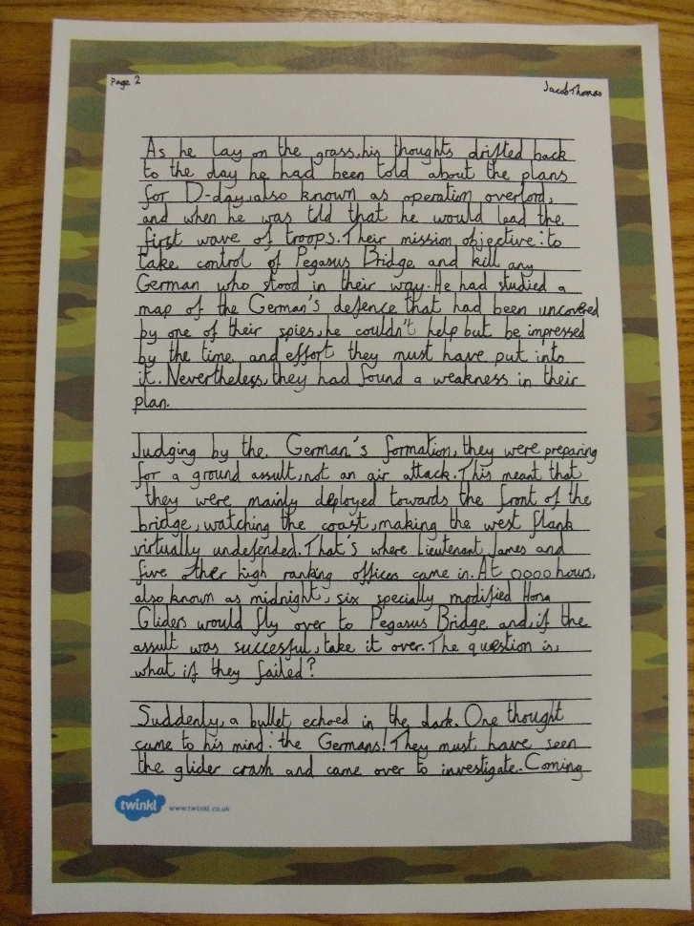
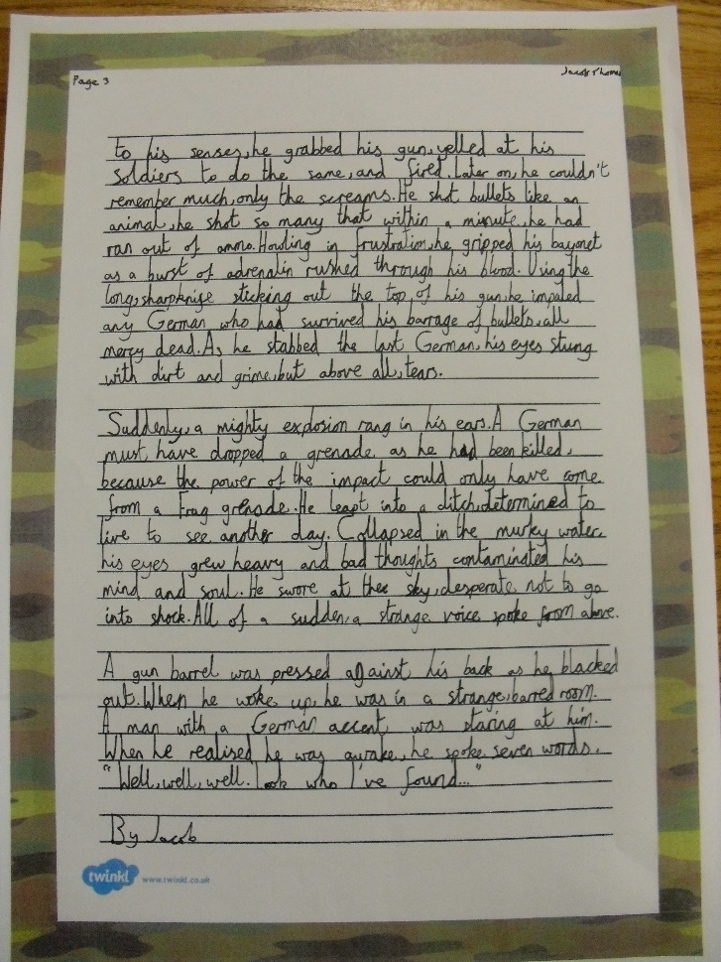
Progress from cold to hot tasks
Year 6 historical narrative hot task

