Slide 1
Assessment at CPS
A new way of working

Slide 2
Background - No more levels
New National Curriculum to be taught in all schools from September 2014 (apart from Y2 and Y6)
“As part of our reforms to the national curriculum, the current system of ‘levels’ used to report children’s attainment and progress will be removed from September 2014 and will not be replaced.” – Department for Education (DfE) publication
This presented schools with a problem, but also an opportunity

Slide 3
What was wrong with levelling?
System was never designed to track progress of children
CPS waited for the Assessment Commission Report November 2015
This report stated that schools should go back to basics and design an assessment system that supports pupil progress, rather than testing whether a child has met a certain threshold
CPS wrote an assessment policy that set out its goals for assessment

Slide 4
3 types of assessment
In-school ‘formative’ assessment
In-school ‘summative’ assessment
External, Nationally Standardised Summative Assessment

Slide 5
In-school ‘summative’ assessment
NAHT Key Performance Indicators (KPIs)
Broad objectives, based on the National Curriculum, that indicate whether a child is working at the ‘expected’ standard for any year group
Based on what a child can and can’t do
Teachers regularly update information as children show understanding in different areas

Slide 6
New Assessment Terminology
Terminology –
T – Target. KPI has been assessed, child shows little understanding and is a key area for them to work on
WT – Working Towards. KPI has not been met fully, but child is beginning to show proficiency in the area – may need support
M – Met. Child has met the KPI and can apply in their work
E – Exceeding. Child has met and gone beyond the KPI and can apply skills in any context independently

Slide 7
New Assessment Terminology
Tracking Descriptors
Give the school an indication of how a child and groups of children are moving through the curriculum content towards end of year and key stage expectations
Stages – 1-6
Emerging
Developing
Secure – this is the end of year expectation
Exceeding

Slide 8
What are the benefits of the change?
Our assessment system is about identifying strengths and areas for development for all children
We are able to use our assessments to match provision, including interventions, to the needs of the child
We are able to track children’s progress through the school’s curriculum, through the progress descriptors
We are able to assess intervention effectiveness, by tracking progress in specific KPIs and comparing that to ‘other’ children

Slide 9
This is a process that we are working through
We are not at the final destination
We are adjusting the system and have an action plan to continue to develop
There have already been stumbling blocks and these will continue to be identified
However, our Assessment Policy sets out the goal – we are clear with where are going and will ensure that we get there

Slide 10
What will this mean for parents?
Information to be shared at parents’ evening
What your child has done well in and what the key areas for development are
Information will be about specific objectives – will allow better conversations about how you can support
Extra support will have a more specific focus – discussions should be more focussed
End of year reporting

Slide 11
National Standardised Summative Assessment
EYFS – Baseline on entry from September 2016
Year 1 Phonics
Key Stage 1
Key Stage 2

Slide 12
Any Questions on in school summative assessment?

Slide 13
End of Key Stage 1 Assessments

Slide 14
KS1
Are statutory- all children must take them unless they are believed to be working well below the expected standard- if this is the case your child's teacher will meet with you and discuss disapplying your child
Are internally marked- at this stage these tests will be marked in school by the child's teacher
Produce a mark which helps inform a teacher judgement - if your child under-performs on the day of the test the teacher will still be able to use their own knowledge to decide if the child has met the national standard

Slide 15
What will be tested?
At the end of Year 2, children will take assessments in:
Reading;
English grammar, punctuation and spelling;
Maths.
The tests are due to take place in May of each year.

Slide 16
The Reading Test consists of two separate papers:
Paper 1 – Contains a selection of texts, of between 400 and 700 words in total, with questions about the text.
Paper 2 – Contains a reading booklet with a selection of passages, of between 800 to 1100 words in total. Children will write their answers to questions about the passage in a separate booklet.
Each paper is worth 50% of the marks and should take approximately 30 minutes to complete, although the children’s ability to ‘work at speed’ is not being assessed, so will not be strictly timed.
The texts will cover a range of poetry, fiction and non-fiction.
Questions are designed to assess the comprehension and understanding of a child’s reading.
Some questions are multiple choice or selected response, others require short answers and some require an extended response or explanation.

Slide 17
Sample Questions

Slide 18
Spelling, Punctuation and Grammar:
2 papers
Spelling: worth 20 marks
Punctuation and Grammar: worth 20 marks

Slide 19
Sample Questions

Slide 20
Sample Questions

Slide 21
Maths

Slide 22
Maths- Arithmetic

Slide 23
Maths- Reasoning

Slide 24
How the tests are scored
The tests will be marked and given a 'raw score'- this is then converted into a scaled score
It is planned that 100 will always represent the ‘national standard’.
Each pupil’s raw test score will therefore be converted into a score on the scale, either at, above or below 100.
The scale will have a lower end point somewhere below 100 and an upper end point above 100.
A child who achieves the ‘national standard’ (a score of 100+) will be judged to have demonstrated sufficient knowledge in the areas assessed by the tests.

Slide 25
How the tests are scored
The tests will be marked and given a 'raw score'- this is then converted into a scaled score
It is planned that 100 will always represent the ‘national standard’.
Each pupil’s raw test score will therefore be converted into a score on the scale, either at, above or below 100.
The scale will have a lower end point somewhere below 100 and an upper end point above 100.
A child who achieves the ‘national standard’ (a score of 100) will be judged to have demonstrated sufficient knowledge in the areas assessed by the tests.

Slide 26
How the tests are scored
On publication of the test results in July 2016:
A child awarded a scaled score of 100 is judged to have met the ‘national standard’ in the area judged by the test.
A child awarded a scaled score of more than 100 is judged to have exceeded the national standard and demonstrated a higher than expected knowledge of the curriculum for their age.
A child awarded a scaled score of less than 100 is judged to have not yet met the national standard and performed below expectation for their age.
Marking guidance for KS1 tests will include conversion tables. Teachers will use these to translate pupil’s raw scores into scaled scores to see whether each pupil has met the national standard. Teachers will use the scaled scores to inform their teacher assessment judgements.

Slide 27
Reporting to parents
You will receive an indication of whether your child has achieved, exceeded or not yet met the national standard for the end of Year 2,
This will be based on teacher assessment and not purely from your child's test results.

Slide 28
Preparing for the test
We will focus on teaching the children the content of the national curriculum rather than preparing explicitly for the test.
We will carry out some low key practice testing with the children, to get them used to the format of the tests.
The testing itself will be done in as ‘informal’ a way as possible to ensure minimum stress, but to adhere to the guidance that we must follow.
We will let you know when testing will be taking place.

Slide 29
End of Key Stage 2 Assessments

Slide 30
Changes this year
No Level 6 SATS papers
Each paper will have questions for higher attaining pupils
No mental Maths paper
An Arithmetic paper
New way of reporting to parents
Pupils will be assessed against the New Curriculum
Tests are still marked externally

Slide 31
SPAG (Spelling, Punctuation and Grammar) Paper

Slide 32
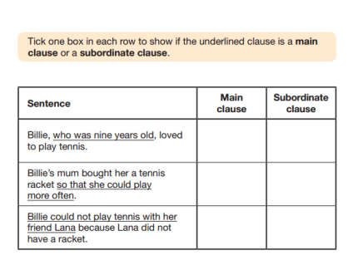
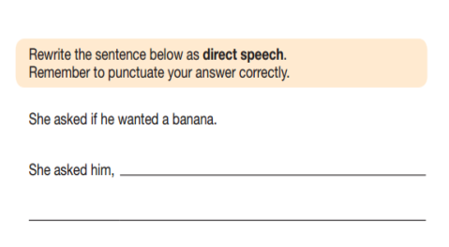
SPAG sample questions

Slide 33
Reading Paper
3 texts to read and
questions on all three

Slide 34
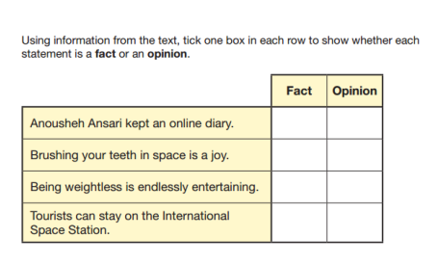
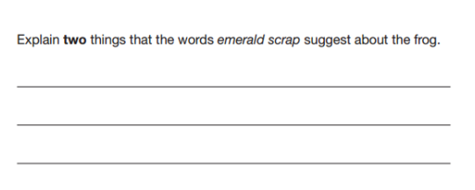
Reading sample questions

Slide 35
Maths Papers

Slide 36
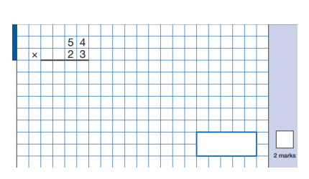
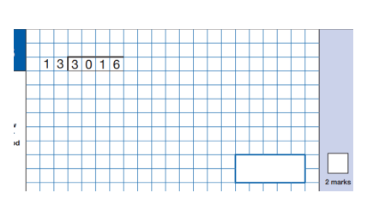
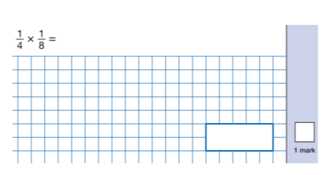
Maths sample questions

Slide 37
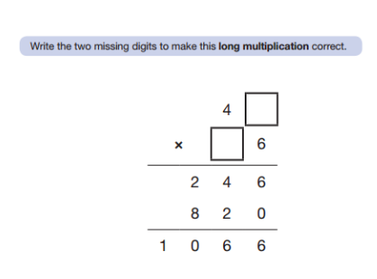
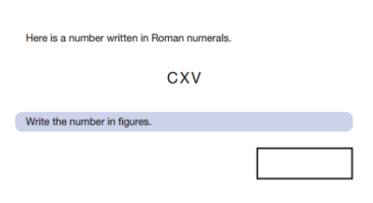
Maths sample questions

Slide 38
Some schools will be selected to do Science papers

Slide 39
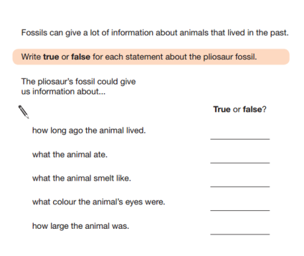
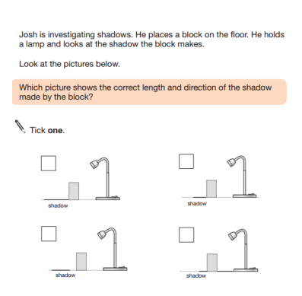

Slide 40
Reporting to parents
Each pupil registered for the tests will receive:
a raw score (number of raw marks awarded)
a scaled score
confirmation of whether or not they attained
the national standard
What is a scaled score?

Slide 41
So, what is a scaled score?
Using scaled scores enables test results to be reported consistently from one year to the next. Though national tests are designed to be as similar as possible every year in terms of demand, slight differences do occur. Scaled scores, however, maintain their meaning over time, so if two children achieve the same scaled score on two different tests, they will have demonstrated the same attainment. In the new scaled score for the national tests, 100 will always represent the ‘national standard’, but the ‘raw score’ (the total number of correct answers) that equates to it may be slightly different each year.
When will we know what 100 means?
The scaled score cannot be set in advance; the national standard and the rest of the scale will be set once pupils have taken the tests and they have been marked. What we do know at this time is that there will be a lower end point below 100 and an upper end point above 100.

Slide 42
Any questions...

