Slide 1
The aims of our curriculum
Every child understands there is no limit to their potential
Every child will receive an excellent all-round education, through an inspiring, purposeful, enriched curriculum
Every child will be provided with the foundations to face the various challenges of life
Every child is an integral part of our community and shares its values

Slide 2
Houses and S.H.I.N.E.

Slide 3
Houses
We have four Houses to match the CVC Houses:
Turing
Bronte
Sanger
Hargreaves

Slide 4
Benefits of the House System
Allows cross phase integration in and beyond the school
A supportive environment for younger pupils to be guided by others
Gives pupils a chance to step up and take on a greater role within the school
An even greater sense of community (a community within our school community)
Equal opportunities and encouragement to realise an individual’s full potential
Building of an individual’s strengths within a group and bonds with other pupils of all ages
Peer support to develop friendships and improve behaviour
Promotion of the ‘student voice’, student responsibility, team skills, leadership skills and co-operation
Extra-curricular activities which enrich, broaden and round off the experiences for our pupils
Development of personal and social skills and well being
Opportunity for pupils to develop deeper knowledge on chosen themes

Slide 5
How it works
All children and staff are allocated to Houses
We have matched siblings to the same Houses including those at CVC
We have two House captains and two House administrator for each House; they are selected from 456 - this year we had 50 applications
We have a weekly House assembly which is led by the House captains focusing on the school’s weekly themes linked to the aims and visions of our curriculum: community, perseverance, aim high there are no limits
House points are given out for good behaviour/good work etc...
House Administrators count up the House points
Each week the winning House is announced in the celebration assembly and the House colours are displayed on the House trophy

Slide 6
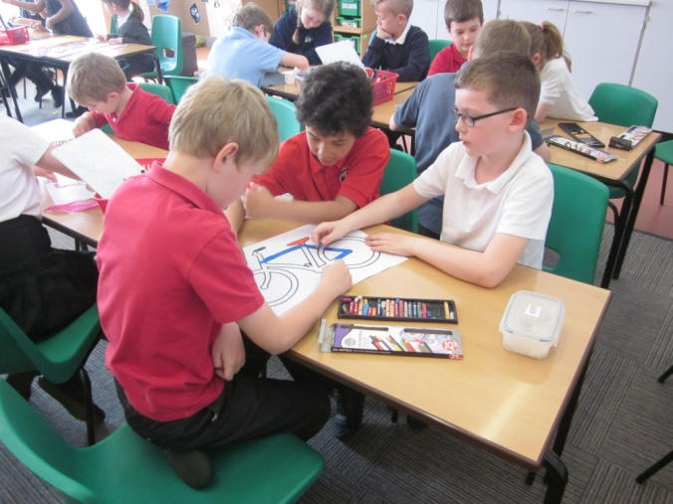
House days and competitions
On House days all children from Reception to Year 6 work together.
Our first House day this term is focused on Roald Dahl’s 100th birthday and then in the second half term our theme will be Anti-bullying and E-safety
We have competitions within the school e.g. Easter Egg decorating and within the cluster e.g.
Year 6 challenge morning
House captains and administrators
take a leading role

Slide 7
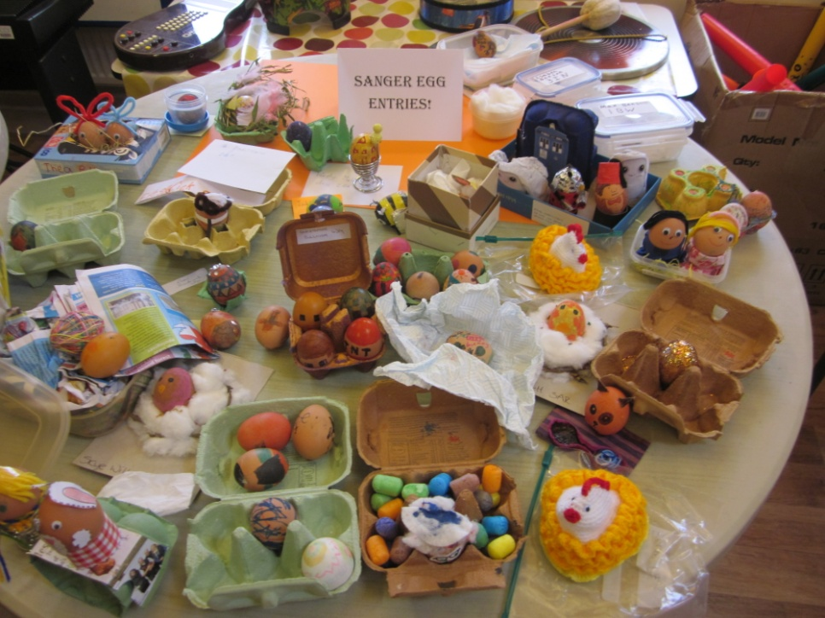
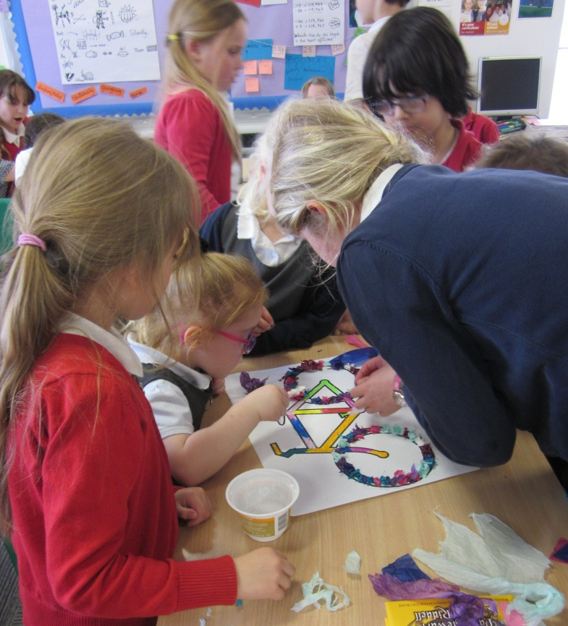
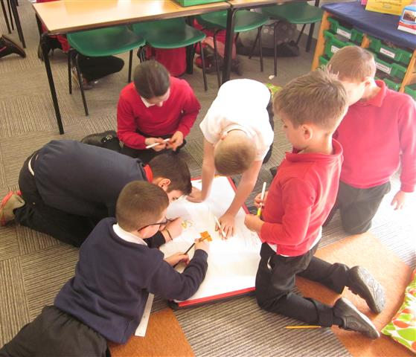
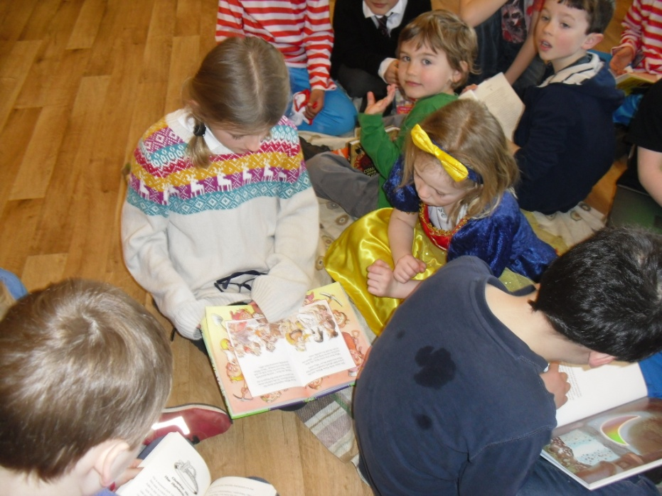

Slide 8
SUCCEED
HELP OTHERS
INSPIRE
NEVER GIVE UP
ENGAGE

Slide 9
How it works
5 categories - S (Succeed), H (Help others), I (Inspire), N (Never give up), E (Engage)
4 levels (Bronze, Silver, Gold, Platinum)
Improves participation by all
Enables pupils to recognise their own achievements
Encourages pupils to set goals and aspire to achieve
Pupils collect evidence to demonstrate they have met the criteria. They need to meet ALL 5 categories to complete a level
Pupils keep their own record of achievement
Achievement of each stage is awarded with 10 HPs

Slide 10
What can my child do?
SUCCEED
I have represented the school or community in a sporting, cultural or academic event
played sport for school or club/ performed in a play / sung in a concert /
HELP OTHERS
I have volunteered my time to support a school or community project
offered help with something without being asked/ helped my parents around the home/ been a y6 monitor
INSPIRE
I have led an aspect of school life
regularly helped your talking partner improve their work/ lead a lunchtime club/ been a wet play monitor/ been a lunchtime play leader/ junior librarian
NEVER GIVE UP
I have overcome a challenging situation or achieved something I thought unachievable in my school, social or personal life
shyness/social anxiety/lack of fitness/academic/independence/life skills
ENGAGE
I achieved something outside of school that I was inspired to do by the school curriculum
personal research/joined a sporting club/created something based on school learning

Slide 11
Talk for Writing

Slide 12
What is Talk for Writing?
Method for teaching writing
Used throughout the school as primary method for teaching writing
Based on idea that children need to embed knowledge of language, sentence structure and knowledge of other non-fiction text types before applying it
As much as possible, links to other curriculum areas
Sits alongside high quality phonics teaching

Slide 13
How does it work?
3 Main Phases- The 3 ‘I’s- Imitation, Innovation, Independent Application
Imitation
Begins with a ‘Cold Task’- Used to inform choice of text and what is taught for the next few weeks
Teachers choose a text which contains sentence structures and language to move on children’s learning
Children learn text off by heart using a text map and actions
Spend some time reading text as a class, developing comprehension skills
Look more closely at key words and phrases within the text
Create a class ‘toolkit’ of features

Slide 14
Text Map

Slide 15
Learning the text
M:\Photos\123\Year 2\2SC 2016-17\CIMG8782.AVI

Slide 16
How does it work?
Innovation
Children work with the original text
Class work together to innovate the text- can be done in a number of ways- Simple switches ( eg: changing character names), changing language choices, writing from a different perspective, expanding one part of the text.
Teachers draw on other high quality texts to model
Writing is modelled by the teacher with children adding ideas

Slide 17
How does it work?
Independent Application
Final stage
Children apply what they have learnt in a piece of independent writing
Could be a piece of writing in another curriculum subject

Slide 18
Why Talk for Writing?
Aligns with school’s aim to provide children with powerful knowledge enabling success
Success rates in other schools have been high
Gives children confidence, particularly when writing at length
Allows children to learn higher level vocabulary and more challenging grammatical concepts in context
Improves children’s speech and language and story telling skills
Provides opportunities for children to regularly write at length

Slide 19
What has the impact been?
Raised profile of writing across the school
End of KS Statutory test data- CPS above national figures for children working at Expected Standard and in Greater Depth towards expected standard
Quality of writing in other curriculum areas has improved as children apply skills

Slide 20
Progress from cold to hot tasks

Slide 21
Progress from cold to hot tasks

Slide 22
Progress across the year

Slide 23
Progress across the year

Slide 24
Maths at CPS

Slide 25
Content
National Curriculum drives content
Fluent in fundamentals of maths
Reason Mathematically
Solve problems
Conceptual understanding and procedural fluency
Objectives on the school website

Slide 26
Number Talks
Regularly used as an introduction to lessons
Gives children a chance to explore different methods to solve a problem
Children encouraged to explain their thinking
Children encouraged to question each other, disagree and challenge
Teacher facilitates the discussion

Slide 27
Number talks
Maths problem on the board
Children indicate whether they have a solution and the number of methods that they are willing to share
Teacher takes responses and scribes for the children, adding their initials or name to their answer/method
Teacher does not highlight correct or incorrect responses
Children then given opportunity to discuss and challenge the answers and methods used

Slide 28
Number Talk – Key Principles
Teacher to remain neutral when answers are given
Children in control and asking/answering questions
Peer assessment/peer coaching opportunities
Praising ‘mistakes’ – interpreting them as opportunities for learning

Slide 29
MiDiSiWi
Make it
Draw it
Say it
Write it
A framework for introducing mathematical concepts and methods to children

Slide 30
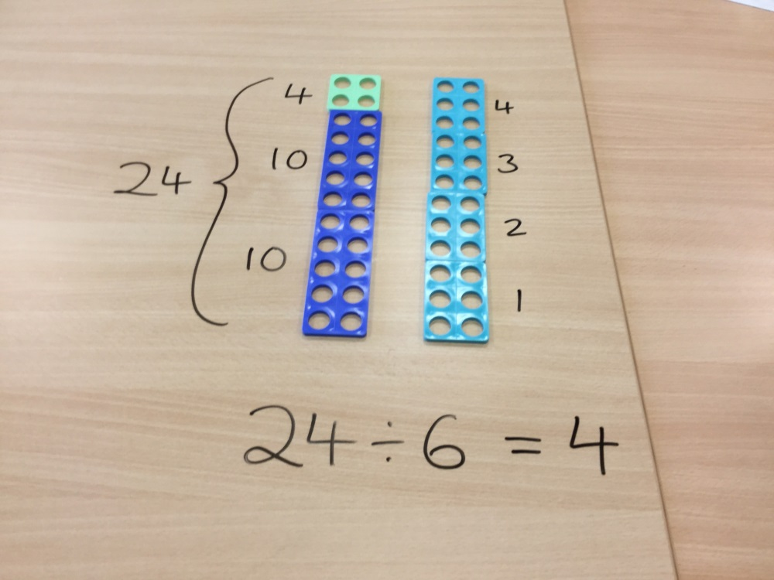
Make it
Variety of real life and physical maths resources

Slide 31
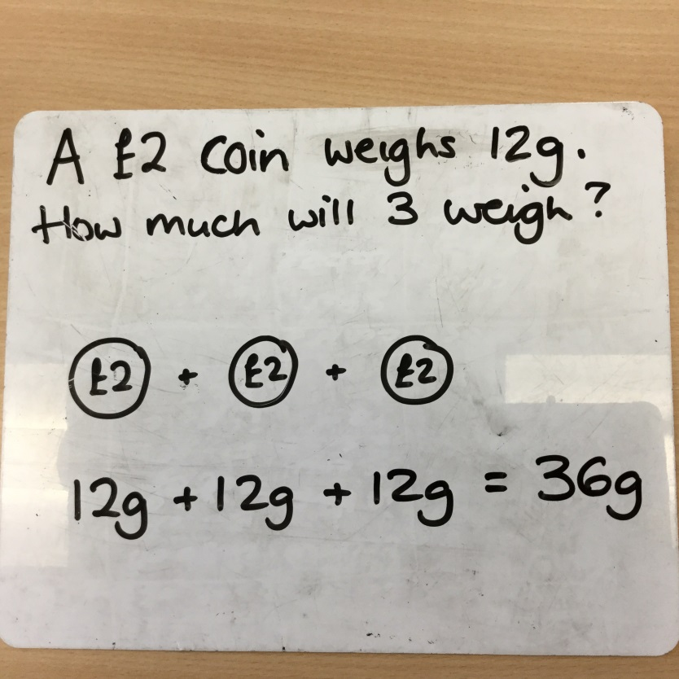
Draw it
Create a visual representation of the concept or calculation

Slide 32
Say it
Children discuss the calculation/concept
They talk it through, explain and reason with it

Slide 33
Write it
This is where the children write the calculation or problem down and carry the calculation through
This might include a ‘formal’ written method

Slide 34
What are the best ways of supporting my child at home?

Slide 35
Ways to support:
Supporting learning at home
Effective home – school communication
Supporting your child to take part in extra – curricular activities
Supporting the school through PTCA and the Governing Body

Slide 36
Supporting Learning at Home
Read with your child …
whatever age they are!

Slide 37
Basic Skills Information Evenings
Reception to Y2: Wednesday 9th November
Y3 to Y6: Wednesday 16th November

Slide 38
Using the LRC
Every child can take one book home at a time from the LRC.
Children can change their books during their timetabled class slot.

Slide 39
LRC Opening Times
Monday 12:30 – 1:00 – Open to all
Tuesday 12:30 – 1:00 – Years 1 and 2
Wednesday 12:30 – 1:00 – Years 3 and 4
Thursday 12:30 – 1:00 – Open to all
Friday 12:30 – 1:00 Years 5 and 6
Thursday 3:10 – 3:40 – For children accompanied by an adult.

Slide 40
Maths
‘I can’t do it!’
‘…yet’

Slide 41
Wider Opportunities
Talk with your child
Share your own interests
Make the most of the local area
Have fun together

