Slide 1


Reading, Spelling and Handwriting
Notes:
Whistle stop tour of Reading, Spelling and Handwriting…
Starting with spelling…

Slide 2
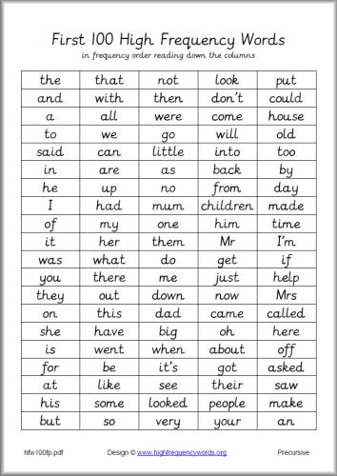
Spelling
We believe in producing highly accurate spellers
Children - play with words, spot patterns, recall, apply rules and conventions
Teachers - provide explicit rules and conventions, opportunity to practise, test retention, correct spellings
Notes:
We believe in producing high accurate spellers…
For the children this means:
playing with words, spotting patterns, recalling, applying rules and conventions
For us the teachers it means
Teaching explicit rules and conventions, creating opportunities to practise and trial these rules, testing retention, correcting spellings in written work according NC ARE expectations. Show list of Year ½ key words example which must be spelt consistently. Other words – plausible attempts using phonics
How we teach... (from the outset)
EYFS daily phonics practise – making connections between sounding out to decode/read a word and sounding out to spell a word
KS1
Daily synthetic phonics programme (Letters and Sounds)
Understanding units of sounds (phonemes) and which different letters (graphemes) make these.
Tasks include: Sound buttoning, counting sounds, matching pictures to sounds, writing, writing, writing
Weekly spelling homework that support the current sounds/phonemes we are teaching in class
Dictations at the end of the week to apply the taught sounds
Weekly opportunities to explore and group words allowing children to spot patterns and build up a schema for spelling conventions
E.g when we use tch or ch in a spelling. Match – short vowel sounds, beach – long vowel sounds
KS2
Use of ‘Spellings Pathway’ N.C which maps out spelling progression across 3 terms from Years 3,4,5,6
Delivered in 3 15 min sessions a week
Dictations/Tests for children to apply knowledge
Spelling homework

Slide 3
Spelling
How we teach...
EYFS | KS1 | KS2
Daily phonics practise - making connections between reading and writing | Daily synthetic phonics (L&S programme) Spelling homework Dictations Weekly word exploration e.g. when we use tch or ch in a spelling. Match – short vowel sounds, beach – long vowel sounds | Use of ‘Spellings Pathway’ N.C 3 x 15 min sessions Dictations/Tests Spelling homework
Notes:
We believe in producing high accurate spellers…
For the children this means:
playing with words, spotting patterns, recalling, applying rules and conventions
For us the teachers it means
Teaching explicit rules and conventions, creating opportunities to practise and trial these rules, testing retention, correcting spellings in written work according NC ARE expectations. Show list of Year ½ key words example which must be spelt consistently. Other words – plausible attempts using phonics
How we teach... (from the outset)
EYFS daily phonics practise – making connections between sounding out to decode/read a word and sounding out to spell a word
KS1
Daily synthetic phonics programme (Letters and Sounds)
Understanding units of sounds (phonemes) and which different letters (graphemes) make these.
Tasks include: Sound buttoning, counting sounds, matching pictures to sounds, writing, writing, writing
Weekly spelling homework that support the current sounds/phonemes we are teaching in class
Dictations at the end of the week to apply the taught sounds
Weekly opportunities to explore and group words allowing children to spot patterns and build up a schema for spelling conventions
E.g when we use tch or ch in a spelling. Match – short vowel sounds, beach – long vowel sounds
KS2
Use of ‘Spellings Pathway’ N.C which maps out spelling progression across 3 terms from Years 3,4,5,6
Delivered in 3 15 min sessions a week
Dictations/Tests for children to apply knowledge
Spelling homework

Slide 4

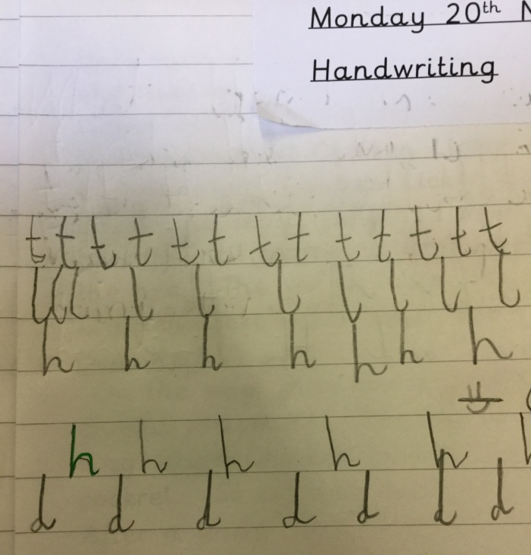
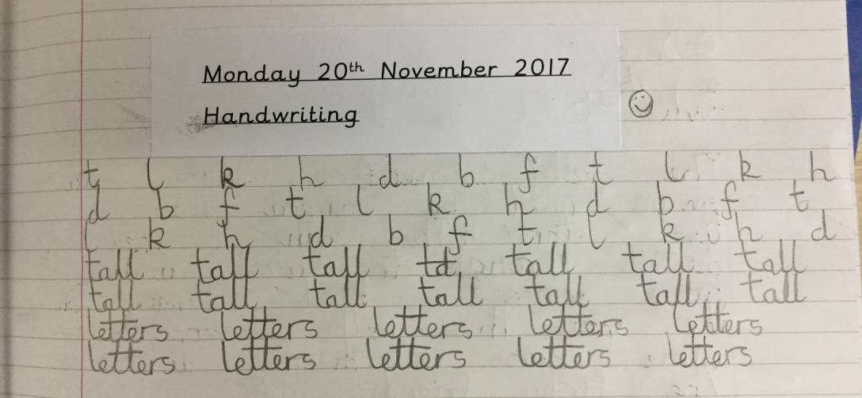
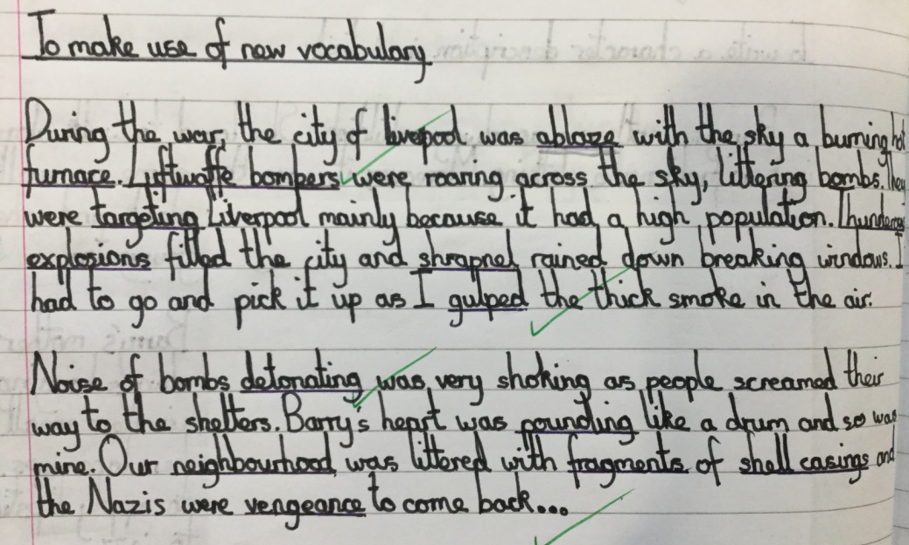
Handwriting
The importance of joined writing
Highest expectations
Notes:
Our philosophy is one where, even in a digital age, the art of joined writing also known as cursive writing is skill a core skill in children’s ability retain knowledge, have pride in their presentation and to demonstrate self worth as writers. Studies have shown that individuals who hand write notes over those that type notes on a device, because they summarise facts/knowledge in their own way, are better able to retain this knowledge. In a study done by Pam Mueller which compared scores of students who took notes by hand and via laptop computer showed that students who took notes by hand showed advantages in both factual and conceptual learning
Expectations are high. Poor formation is a real barrier to progress in early written literacy. Children need to be able to clearly read their written work in order to check and edit their work for spelling, punctuation and grammar mistakes.
How we teach...
Consistency in our approach
We follow the recognised Nelson scheme – providing consistency in teaching across the school age range
Modelling from teachers
Start early
Children start a set cursive formation from EFYS through to Year 6
Children will be taught units of sound (digraphs) as a cursive join from EYFS
Weekly handwriting sessions (heavy modelling by teachers – application by children – assessment)
Targeted booster formation sessions as directed by class teachers for those children with greater fine motor skill needs
Expectations…
that children should securely joining a cursive style by the end of Year 2
Expectation that children will begin to explore their own clearly legible handwriting style once they
Goals
Build towards a pen license

Slide 5
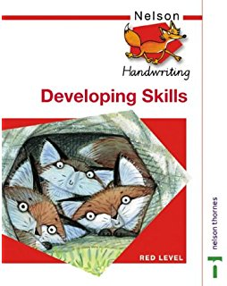

Handwriting
How we teach…
consistency of approach
start early
weekly handwriting sessions
targeted formation sessions
expectation
set goals
Notes:
Our philosophy is one where, even in a digital age, the art of joined writing also known as cursive writing is skill a core skill in children’s ability retain knowledge, have pride in their presentation and to demonstrate self worth as writers. Studies have shown that individuals who hand write notes over those that type notes on a device, because they summarise facts/knowledge in their own way, are better able to retain this knowledge. In a study done by Pam Mueller which compared scores of students who took notes by hand and via laptop computer showed that students who took notes by hand showed advantages in both factual and conceptual learning
Expectations are high. Poor formation is a real barrier to progress in early written literacy. Children need to be able to clearly read their written work in order to check and edit their work for spelling, punctuation and grammar mistakes.
How we teach...
Consistency in our approach
We follow the recognised Nelson scheme – providing consistency in teaching across the school age range
Modelling from teachers
Start early
Children start a set cursive formation from EFYS through to Year 6
Children will be taught units of sound (digraphs) as a cursive join from EYFS
Weekly handwriting sessions (heavy modelling by teachers – application by children – assessment)
Targeted booster formation sessions as directed by class teachers for those children with greater fine motor skill needs
Expectations…
that children should securely joining a cursive style by the end of Year 2
Expectation that children will begin to explore their own clearly legible handwriting style once they
Goals
Build towards a pen license

Slide 6
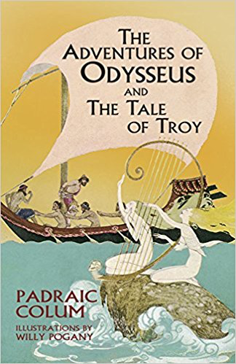


Why is reading important at CPS?
‘The simplest way to make sure that we raise literate children is to teach them to read, and to show them that reading is a pleasurable activity. And that means, at its simplest, finding books that they enjoy, giving them access to those books, and letting them read them.’ Neil Garman, children’s author
Our philosophy is reading for pleasure
give everyone an equal chance in life by helping children become well rounded, confident and enthusiastic readers.
Access to great texts
variety of genres
sharing classic texts
Notes:
Why is reading important at CPS (our philosophy)?
We firmly believe in fostering a ’reading for pleasure’ ethos in our children so that they leave our school as well-read individuals who demonstrate an enjoyment of reading and fully understand its value
give everyone an equal chance in life by helping people become confident and enthusiastic readers. Quality
We want to give children access to great texts which means
Teachers carefully selecting the texts in their plans
Text selection which compliment and enhance a topic or a unit of work in literacy
Enriching children with a variety of text genres
Examples…
Teachers sharing classic texts
Examples…

Slide 7
How do we teach reading?
EYFS/KS1
Developing agency around decoding
KS2
Developing fluency and comprehension
Notes:
If you look at a persons lifetime of reading and expanding their minds through literature and then knuckle down to that seminal time of primary education, the rate of progress in reading is phenomenal between the ages of 5-11
Majority of children cannot read when they enter EYFS
To explain that progress in more detail…
In EYFS through KS1 we focus on fostering a love of reading whilst ensuring that children are developing a sound skill set and agency surrounding how to decode new words. ‘How did you solve that’
This process then overlaps with developing fluency and comprehension
As the process of decoding becomes innate and children access texts more freely, we look to enhance fluency of children’s understanding of what they are reading.

Slide 8
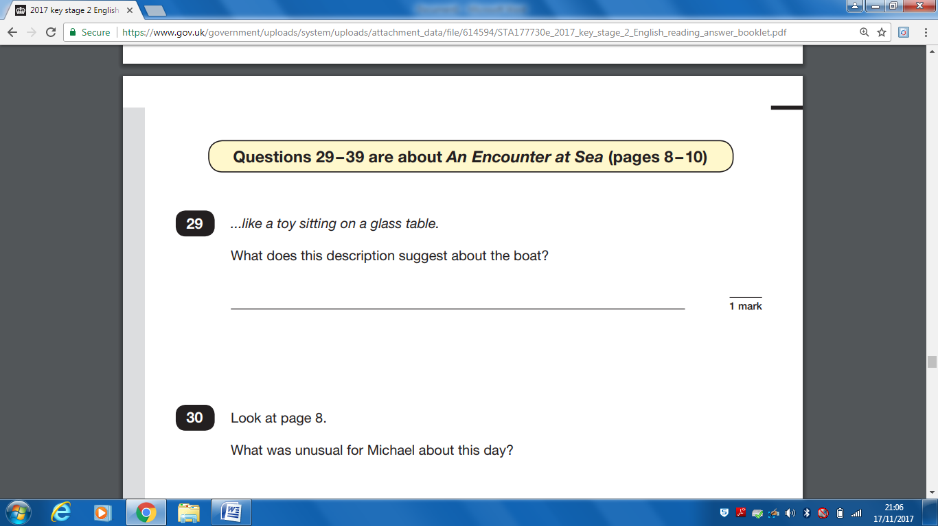
Optimising opportunities for reading in the school day
Teacher-led guided reading sessions (small group and whole class), assemblies, weekly class library sessions, end of the day stories, army of pupils/staff running the LRC at lunchtimes, LRC incentives, reading cafe
Supporting readers on a reading continuum
Develop comprehension skills to answer of sophisticated questions. Through explicit teaching and dialogue we enable children to achieve a sound grasp surrounding inference and authorial judgements
Transitional readers
self-extending readers
early readers
Notes:
So how do we support these two key areas of development?
We look to optimise through
Teacher-led guided reading sessions (small group and whole class), assemblies, weekly class library sessions, end of the day stories, army of pupils/staff
We support children along a continuum using Synthetics phonics, modelling and questioning to develop children’s fluency (which includes developing comprehension, developing opinions)
We support children’s ability to comprehend sophisticated question and look to ensure that they producing a sound grip on inference and authorial judgements

Slide 9
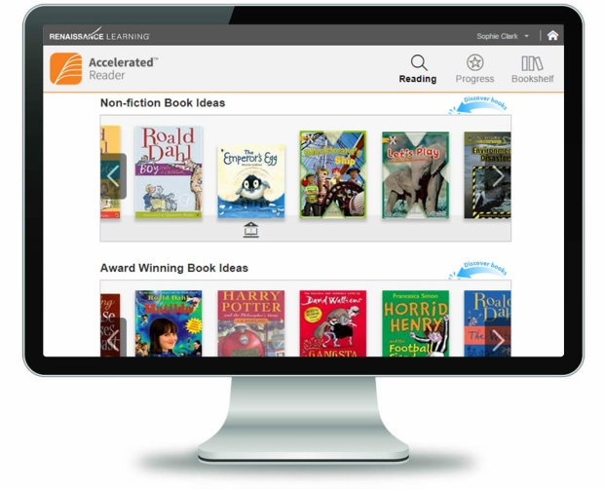
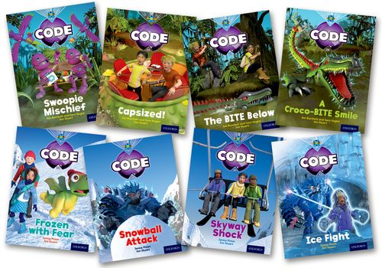
What can we all do to help?
Ask children what they are reading
Work with the school’s schemes
Accelerated Reader
Project X
Weekly guided reading books (KS1)
Model – plenty of books out and about at home!
Do not discourage children from reading because you feel they are reading the wrong thing.
We need our children to get onto the reading ladder: anything that they enjoy reading will move them up, rung by rung, into literacy.
Notes:
Ask children what they are reading
Work with the schools schemes
Accelerated Reader
Project X
Weekly guided reading books (KS1)
Model at home!
No conflict with what they are reading

